Slide 1
Mobile Dev Ops at Scale
Lessons on how to scale mobile application deployments

Slide 2
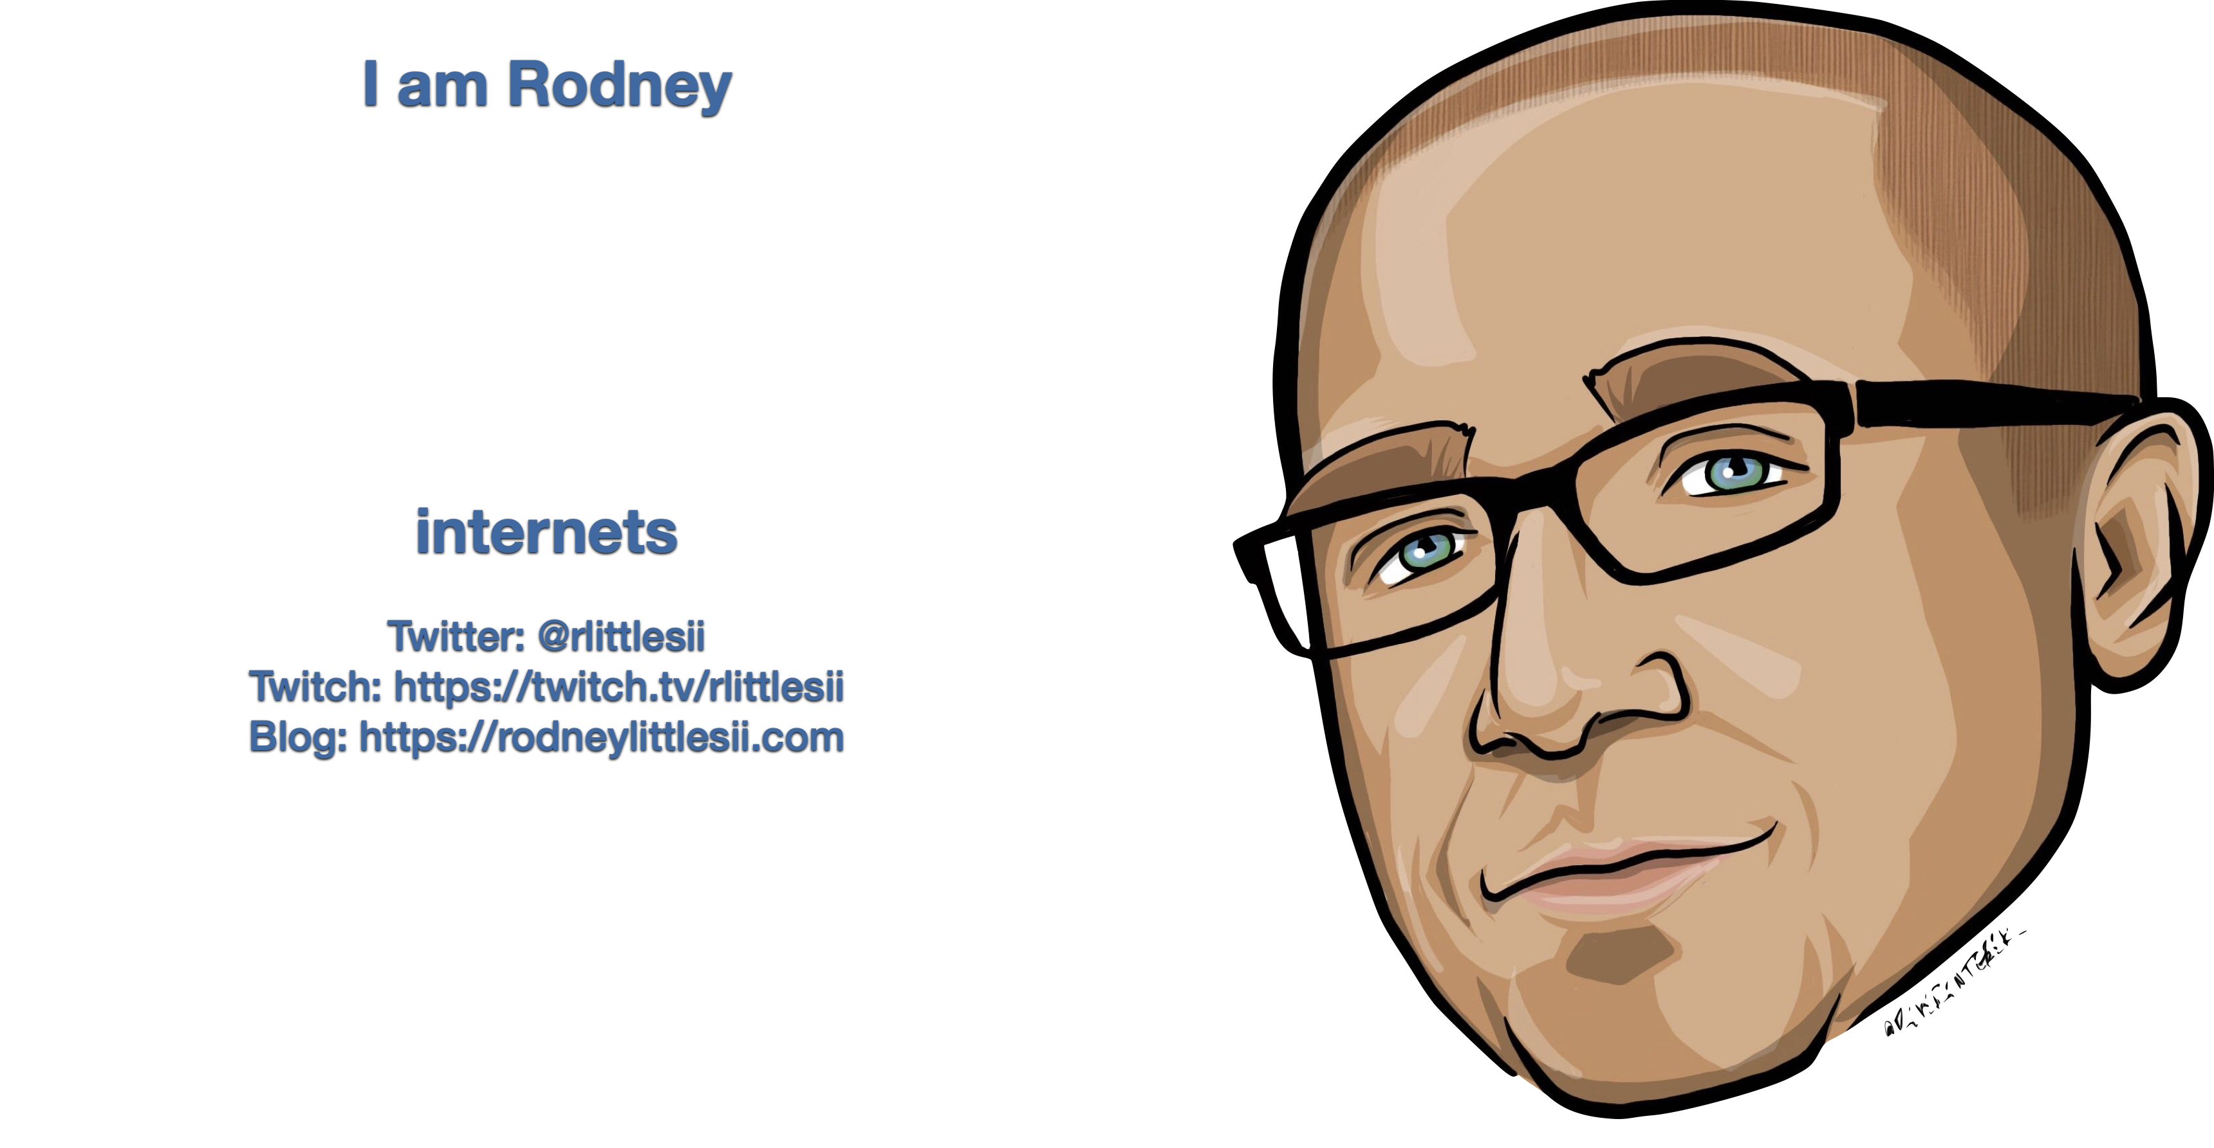
Notes:
I am a Senior Mobile Architect I am a ReactiveUI maintainer
I am a functional programming advocate I am a Microsoft MVP
You can find me on the internets and we can speak geek.

Slide 3
The Definition
High level overview of Mobile Specific Concerns
Demonstration
Branching
Versioning
Integration
Deployment
Notes:
Focusing on Enterprise, but I use all these same concepts on any project of any size
We will start with high level concerns of Mobile build requirements
We will go directly into our code sample and demonstration of the process
We’ll talk about branching
We’ll talk versioning
We’ll talk integration
And lastly we’ll talk deployment
The whole time pointing our tools that can help boost your build process

Slide 4
Disclaimer
These are opinions based on my experiences
Notes:
Primarily talking from the iOS world
This will be git specific because I haven’t used TFVC on a mobile project ever.
I’ve seen Xamarin Teams of various sizes
1
5
15
Not everything will be applicable to your organization listen for the parts that may work in your world!
Some things are enterprise related, others are app store related

Slide 5
There are no best practices, just some better than others.”
Rodney Littles, II
You have to be willing to evaluate trade offs.
Notes:
This is not that kind of dev ops talk.
I am more Dev than Ops!
I am a developer doing ops, I have that lense.
I can’t tell you the right way to do things.
I can tell you what are good things to do.
Things you should avoid because they cost.
Really I just want to give you ideas of the possible.

Slide 6
Right click publish all the things™!
Human dependency
Not scalable
Security risk
Notes:
I like to vacate
I don’t like to be responsible for production certificates
I am a dev, not an ops
I’ve done this, it isn’t great

Slide 7
CI is universal …
Restore
Build
Publish
Release
Notes:
dotnet cli does the majority of the heavy lifting. We acknowledge that it calls msbuild under the covers, where they don’t want you to look!
Why write a build script when you can call the dotnet cli?!
Releasing is simple enough to just do it in YAML
My build system won’t change.
Until it isn’t easy enough to do in YAML and you have to change build systems.

Slide 8
But it’s not …
Deploying binaries
Side by Side installations
Concerns of environment specific configuration
MSBuild only, no dotnet cli
Binaries must be signed
Notes:
Mobile CI is more akin to desktop ci
Deploying Binaries
Side By Side
Testers already hate developers
Imagine if they had to uninstall and reinstall to verify environment specific issues?!
Change configuration of binaries for specific environments
Mobile currently requires use of msbuild cli
Binaries have to be signed

Slide 9
Demonstration

Slide 10
Scale
Notes:
We talk about this concept of “scale”
In general what we mean by this term is, how to I get more.
More Resources
More users
More power
More speed
Increase throughput
Automate the things you can
Reduce human interaction
Allow the robots to do the task
Scales denote balancing, so you have to give something to achieve balance
Trade offs around what are the important things to you
I want something cheaper, faster, better pick two
I want to reach more user

Slide 11
Branching Strategy
How you branch your code determines how you release software
Notes:
I once had a manager ask me “Why does what’s in the repository need to compile?”
Your branching strategy along with your testing strategy can determine how fast, accurately and among other things how quickly you can release

Slide 12
So many options
Git Flow
Git Hub Flow
Mainline
Team Collaborative
Choosing the correct strategy for your team
Notes:
Martin Fowler has a great article about this

Slide 13
What’s the right way to branch?
Main should be your source of truth
Recommend mainline if your testers are helping you fail fast
Too many branches will eventually lead to instability
Small frequent integrations are preferred
Notes:
Integrate often
Release when ready
Branches don’t diverge linearly, the diverge exponentially

Slide 14
What’s the wrong way to branch
Retarget main
Create branches from branches
Cherry-Pick
`git wrecked`
Notes:
Your main branch should be your source of truth. You should do your best not to force push or retarget it to another branch.
Use release branches to stabilize, not as a release point. Tags
Wrong practices lead to what I call `git wrecked`
Where you are using features of the tool, and eventually the tool is harder to use, because of inefficient use
Imagine a screw driver that we use as a chisel, eventually, it won’t turn screws as well

Slide 15
Versioning
How do we offer support for a given version of an application?
Notes:
User downloads a new version from the app distribution service of choice
How do they notify you of a problem?
How do we notify of a fix?

Slide 16
1.x.y.abcd doesn’t always make sense
Stable apps
YYYY.Major.Minor
Beta Apps
Sem Version + Build Number
Multi-Version Support
Major.Minor.Revision
Sometimes Major should be set and Minor.Revision.Patch should be used
Notes:
As a software dev I use a lot of software
Versions are meant to signify
Maturity
A point of order for support
A particular available feature set
Versions are arbitrary, make them work for you!
Seeing more YYYY format, which has advantages
It’s user friendly
It marks a point in actual time relevant to the user
Gives you a clear understanding of it’s age
Semantic Version
Theres a spec
Spec gives consistency
Leans towards a concept of maturity

Slide 17
What’s in a version?
More versions is more support
Forcing upgrades isn’t easy
One bad version could cause long term issues
Multiple client versions to multiple server versions
Keeping connections correct between versions

Slide 18
Continuous Integration
Pushing competing code to an environment where it has to work together

Slide 19
Continuous Integration
The first time all the code across the developers is put together
Volatile
Buggy
It is a fully released binary
Needs to consider upgrade path early

Slide 20
Code Quality
Style Cop
FxCop
Roslyn
Inspect Code
Duplicate Code
Notes:
Static Code Analysis
Compile time code styling analysis
Closer to the developer life cycle
Forces styling on the developer
Tool Analysis
Build time code styling analysis
Styling checked by the build system
More failed server builds

Slide 21
Automated Tests
Self Testing Code is important
TDD / BDD / Just Test Me
Refactor with confidence
Refactor often
Bugs create tests
Notes:
Self Testing Code
Unit Testing
Closest to the developer life cycle
Integration Testing
Harder due to platform specific integrations
Functional Testing
Acceptance Testing
UI Testing
Xamarin UI Tests
Take longer to run
TDD is good
BDD is my preference
No Tests is a path to sadness and bugs
Refactor with confidence
Refactor often
Bugs happen, but they spawn new tests!

Slide 22
So many options what to chose?
Notes:
We really are luck in our choices today
We need a CI System to delegate the build/release process to
We need a way to build our code on that CI system
We need a way to distribute our code after it has been “released”

Slide 23
Where to begin?
Build Scripts allow developers to run the build locally
Developers should be empowered to change the build
Choosing a CI system can influence this choice
GitHub Actions
Bitrise
Azure Pipelines
Notes:
Criteria:
Check in the script with the source code
No designer tools unless they emit usable script that can be committed
If it is local to the solution, developers can read it and change it
If it’s local to the solution, and there is a script executor, developers can run it
In the absence of an ops team, developers can own this process
CI like GitHub Actions and BitRise have mechanisms to run the YAML locally
Azure Dev Ops runs a

Slide 24
Where should it live?
Execute Locally
Allows your developers to exercise the build process
Catch some build errors early
Reasons why YAML is not my favorite
Execute On Server
Mandatory
Additional processes not executed on a developers machine
Notes:
I am a fan of build scripts living close to the code that they build
Developers execute it regularly
Someone is testing our build process
We still have local concerns verses server concerns
How do we verify server concerns?

Slide 25
Yet Another Markup Language
YAML seems to be the default standard for build systems
YAML doesn’t satisfy the concern of running the build script locally
YAML Editors make this easier

Slide 26
Maybe a scripting DSL
Cake
Nuke
Build scripting in C#
Modular
Scripted approach
More for Ops Engineers
C# application
Extensible
Code approach
More for Developers
Notes:
Both have a learning curve
Both have pros an cons
Both are GREAT tools
Both have trade-offs
Use the tool that works for your team
I use and love both these tools

Slide 27
Or maybe try …
MSBuild
Mobile Build Tools
Shell scripts
Fastlane
Notes:
Dan Siegel wrote a set of build tools that is a collection of MSBuild Tasks
It handles the following
Image Assets
Release Notes
Application Configuration
Application Manifests
You can always use Shell Scripts
This is not my preference because with Xamarin and soon MAUI
You need to ensure it works for both iOS and Android
Prefer technology agnostic solutions where possible to reduce friction
Fastlane has an entire suite of tools
Build
Provision
Deliver
Pilot
All configuration based, all amazing!

Slide 28
Continuous Integration += Continuous Improvement
If it’s good enough for our code, why not our build process
Notes:
As your code grows and gets refactored, so should your build.
You should be striving for ways to shorten your build system.
The quicker you can build, the faster you can release.
Always look for the longest part of your build process and try and reduce the time it takes to complete.
Code bases grow, test suites grow and take longer to execute, so reduce time where you can that makes sense.

Slide 29
Continuous Delivery
Build once deploy everywhere

Slide 30
Code Signing
Sign the same binary for each environment
Signing is required for deployment
Signing is technology specific
Notes:
The point of order always comes up “Yeah, but if you rebuild to change environment, it’s not the same binary!”

Slide 31
Apple Code Signing
Signing Service
Fastlane
Manually update
Notes:
Signing service allows you to centralize the certificates and provisioning profiles
Fastlane allows automatic creation and distribution of certificates and profiles
Manually update certificates and profiles
Not my favorite

Slide 32
Distribution System
AppCenter
Former known as HockeyApp
TestFlight
iOS Specific
Appstore / Play Store
Apple reviews applications, including incremental changes
Fastlane can handle distribution
Notes:
Mobile platforms each control their own distribution system
You cannot just post an ipa on a website for download
You have to distribute through the technology specific distribution system
You have to use a distribution system to test code

Slide 33
Go Build and Release
Notes:
We’ve talked about
Why you automate builds
What tools you have available
How you branch your code
How you version your software
How you build
How you release

